Slide 1

PAY ATTENTION!
THIS MEANS YOU!

Slide 2

RULE……33
NEVER RETURN UNUSED CHEMICALS TO THEIR ORIGINAL CONTAINERS
(HEY YOU THERE, FUNNY GUY, DON’T DO THIS)

Slide 3
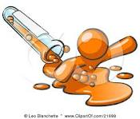
NEXT! RULE……37
HANDLE FLAMMABLE HAZARDOUS LIQUIDS OVER A PAN TO CONATIN SPILLS
(DON’T COME CRYING TO ME IF YOU SET THE LAB ON FIRE. I WARNED YOU)

Slide 4
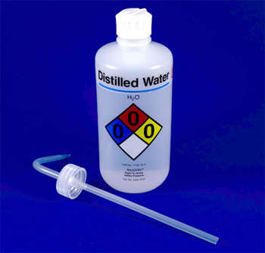
THE THIRD!........RULE 47
FILL WASH BOTTLES ONLY WITH DISTILLED WATER (ONLY AS INTEDNED)
(CLEAN YOUR STUFF, OR I’LL FIND YOU!)

Slide 5
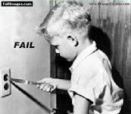
THE LAST RULE!......44
WHEN REMOVING AN ELECTRICAL PLUG FROM ITS SOCKET, GRASP THE PLUG, NOT THE ELECTRICAL CORD (WITH DRY HANDS).
( I DON’T ALWAYS PULL PLUGS OUT OF SOCKETS, BUT WHEN I DO, I GRASP THE PLUG WITH DRY HANDS. STAY SAFE MY FRIENDS.)

